Slide 1
QuickBase craft challenge

Slide 2
The application
A simple hello-world web app. https://github.com/shubhag/docker-nodejs-helloworld
Deployed as a Docker container in AWS ECS

Slide 3
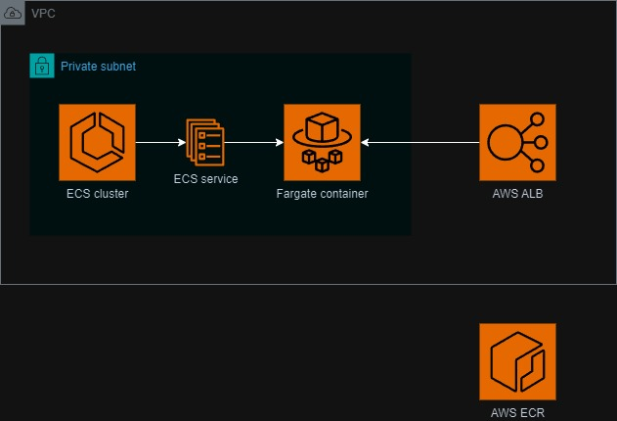
Infrastructure pre-requisites

Slide 4

Deployment script

Slide 5
Was the deployment successful
aws ecs wait services-stable
Review fargate container logs for exceptions thrown from the application
Smoke testing
Monitoring

Slide 6
Monitoring
CloudWatch metrics
CloudWatch logs
CloudWatch alarms which send incidents to PagerDuty
and/or 3rd party systems like ELK for log collection, troubleshooting and sending alerts to PagerDuty
Uptime.com for endpoint healthcheck
Application Performance Monitoring with Datadog or similar

Slide 7
Security policies and scans
Do not use AWS root account. Create users/groups and apply least-privilege principle for their access. Enable MFA
Consider SSO for login into all systems, e.g. AWS IAM Identity Center, Azure AD SSO, Okta
Apply network access controls using security groups
Record infrastructure configuration and audit logs with AWS Config and AWS CloudTrail
Encrypt logs and data with AWS KMS
ECR scan on push and AWS Inspector for reviewing vulnerabilities

Slide 8
CI/CD improvements
Unit tests and PR review approval required before merging code
Static code analysis and quality gate with SonarQube
Build the application
After successful deployment start automation tests
Send success or failure messages to Slack

Slide 9
More DevOps practices
Multiple environments
Dedicate 1 staging environment for regression testing. Performance testing if needed.
AWS Well-Architected framework
  Infrastructure as code
  High-availability and failovers
  Backups and disaster recovery plan
  Caching
  Optimize for cost
  Sustainability

Slide 10
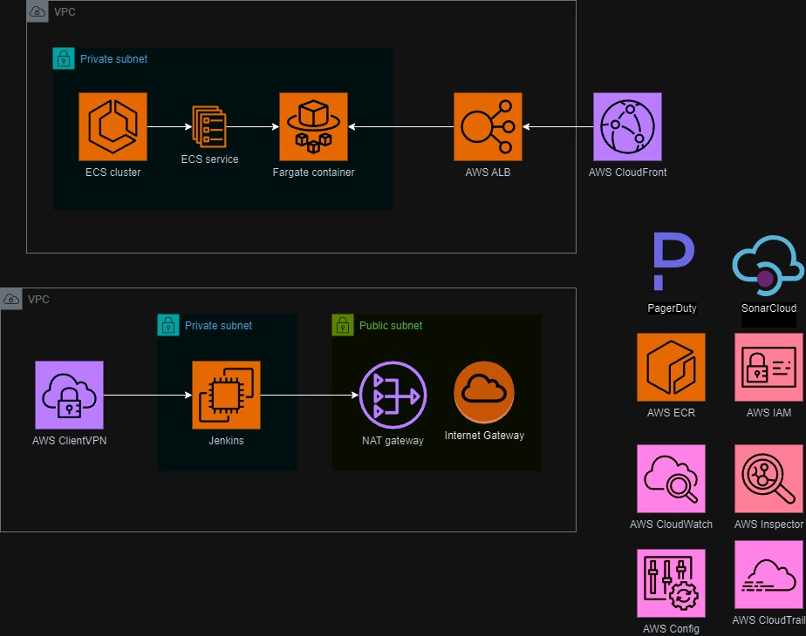
Improved diagram

